Slide 1


Slide 2
Program Structure and Structure Charts
Every program has a structure
Structure Chart - graphic representation of structure
SC represents modules and interconnections
Each module is represented by a box
An arrow from module A to module B represents that module
A invokes module B. B is called the subordinate of A, and A is called the superordinate of B
If A invokes B, an arrow is drawn from A to B
Arrows are labeled by data items

Slide 3
Diff types of modules
There are some modules that obtain information from their subordinates and then pass it to their superordinate. This kind of module is an input module.
there are output modules, that take information from their superordinate and pass it on to its subordinates.
As the name suggests, the input and output modules are typically used for input and output of data from and to the environment.

Slide 4
Diff types of modules
The input modules get the data from the sources and get it ready to be processed, and the output modules take the output produced and prepare it for proper presentation to the environment.
Then there are modules that exist solely for the sake of transforming data into some other form. Such a module is called a transform module.
Most of the computational modules typically fall in this category.

Slide 5
Diff types of modules
Finally, there are modules whose primary concern is managing the flow of data to and from different subordinates. Such modules are called coordinate modules

Slide 6
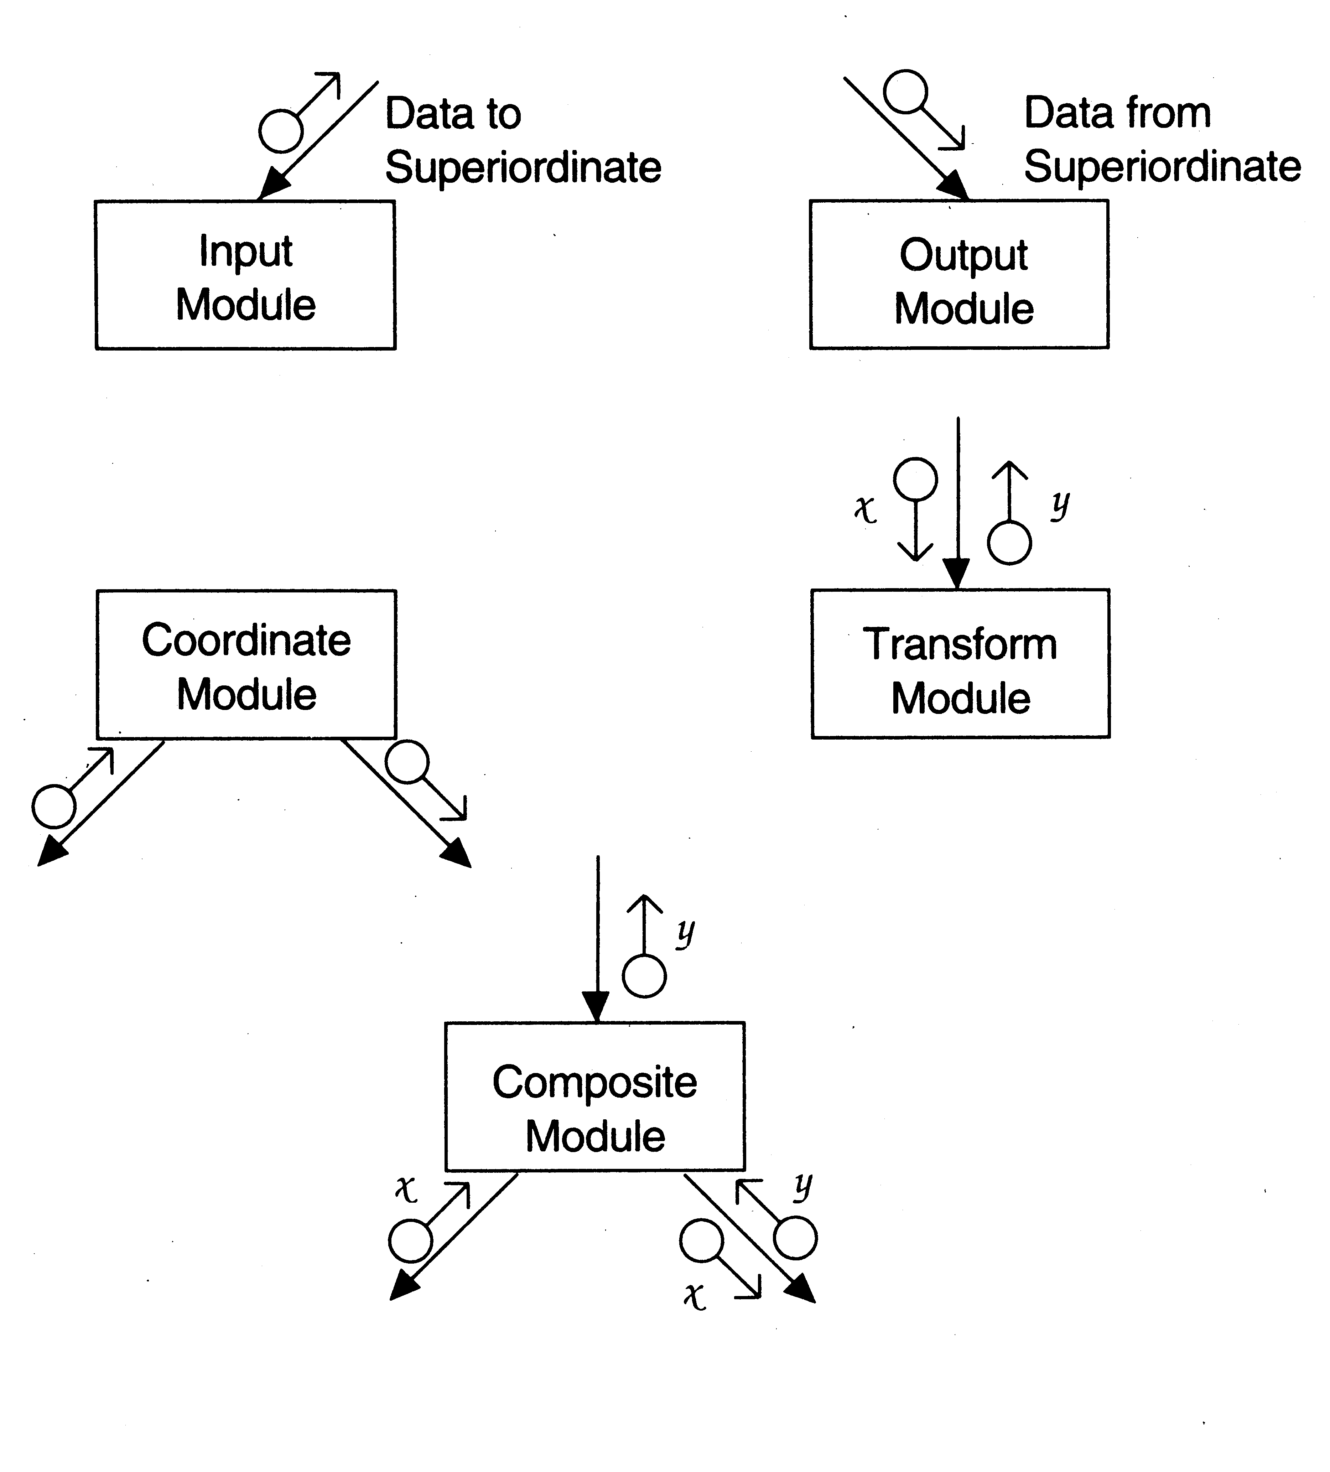
Diff types of modules

Slide 7
SC shows the static structure, not the logic
Different from flow charts
Major decisions and loops can be shown
Structure is decided during design
Implementation does not change structure
Structure effects maintainability
Structured Design Methodology (SDM) aims to control the structure

Slide 8
Sort program
main ()
{
i n t sum, n, N, a[MAX];
readnumsCa, &N); s o r t ( a , N); scanf(&n);
sum = add_n(a, n) ; p r i n t f ( s u m );
}
r e a d n u m s ( a , N)

Slide 9
Sort program
int a [] , *N ;
{
...
}
s o r t ( a , N)
int a[] , N;
{
if ( a [ i ] > a [ t ] ) s w i t c h ( a [ i ] , a [ t ] );
}
/* Add the first n numbers of a */
add_n(a, n)
int a [] , n ;
{
.....
}

Slide 10
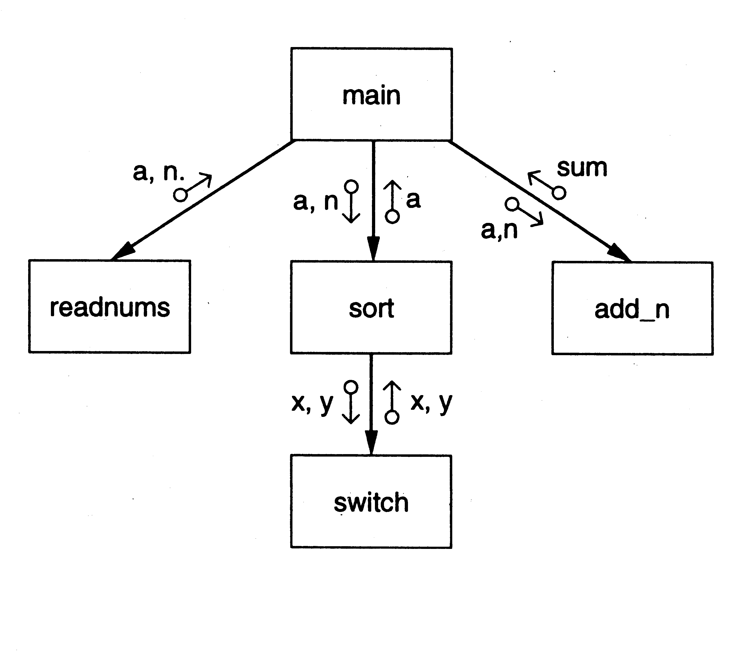
SC of a Sort Program

Slide 11
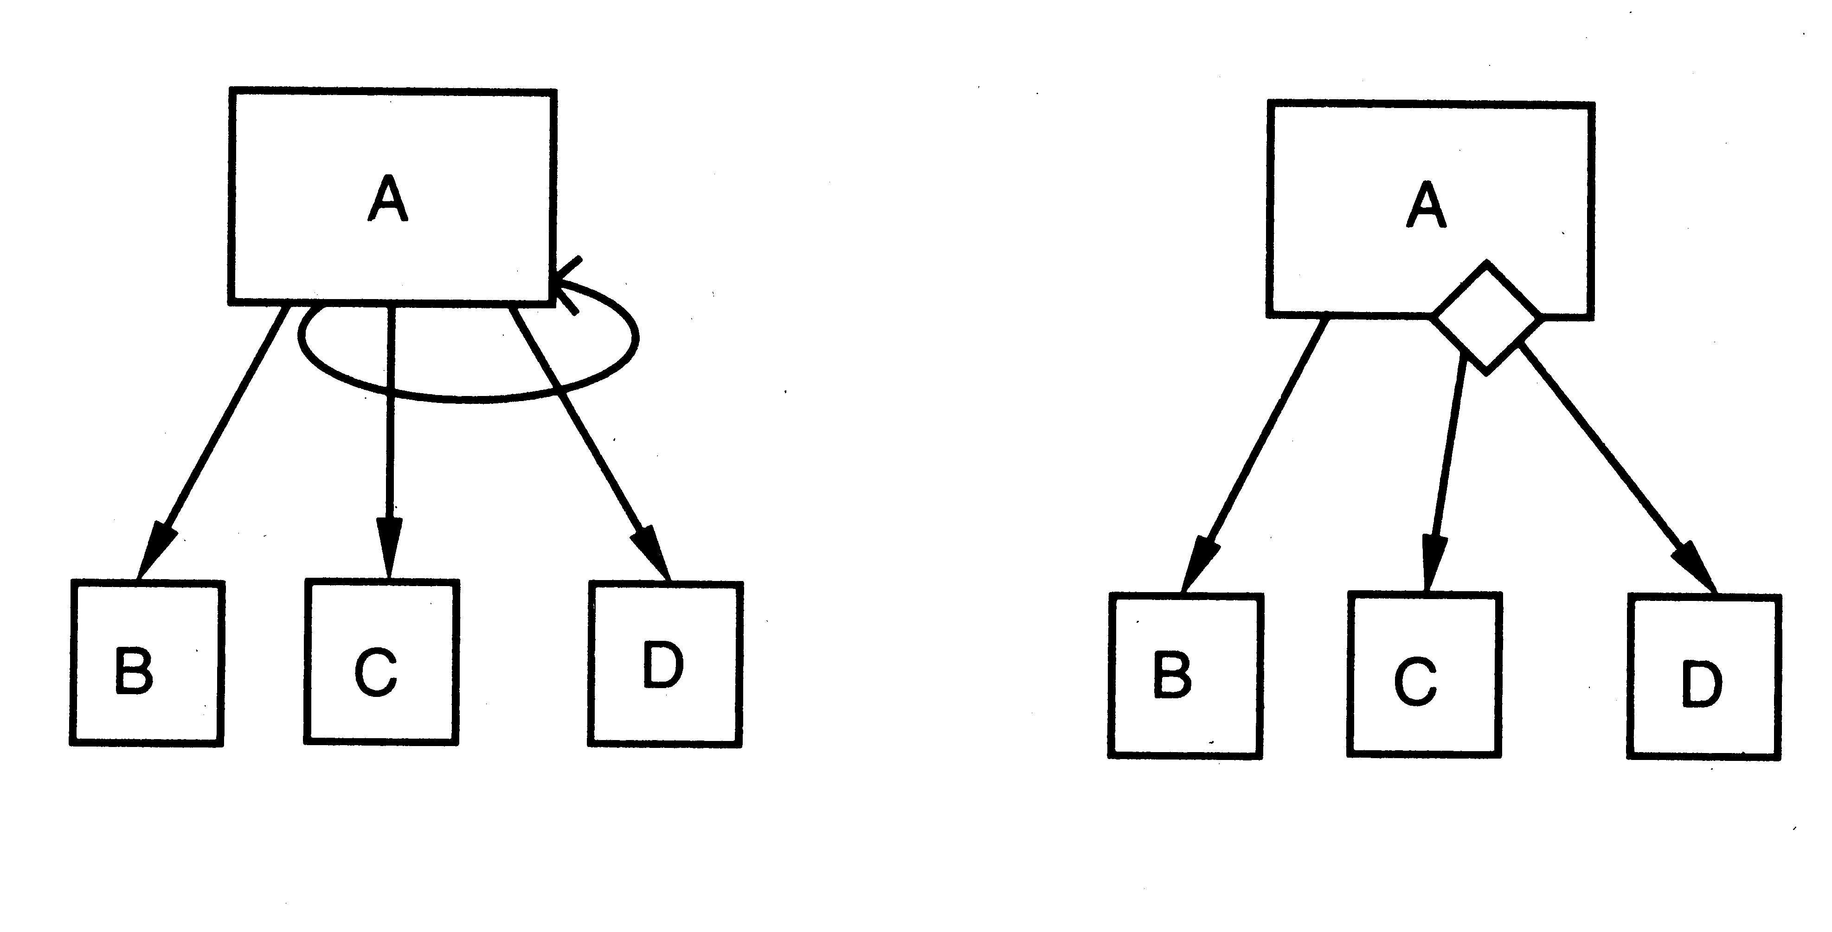
Iteration and decision

Slide 12
STRUCTURED DESIGN METHODOLOGY
SDM views software as a transformation function that converts given inputs to desired outputs
The focus of SD is the transformation function
Uses functional abstraction
Goal of SDM: Specify functional modules and connections
Low coupling and high cohesion is the objective
Transformation
functions
Input
Output

Slide 13
Main Steps in SD
Draw a DFD of the system
Identify most abstract inputs and most abstract outputs
First level factoring
Factoring of input, output, transform modules
Improving the structure

Slide 14
Data Flow Diagrams
SD starts with a DFD to capture flow of data in the proposed system
DFD is an important representation; provides a high level view of the system
Emphasizes the flow of data through the system
Ignores procedural aspects
(Purpose here is different from DFDs used in requirements analysis, thought notation is the same)

Slide 15
Drawing a DFG
Start with identifying the inputs and outputs
Work your way from inputs to outputs, or vice versa
  If stuck, reverse direction
  Ask: "What transformations will convert the inputs to outputs"
Never try to show control logic.
  If thinking about loops, if-then-else, start again
Label each arrow carefully
Make use of * and +, and show sufficient detail
Ignore minor functions in the start
For complex systems, make DFG hierarchical
Never settle for the 1st DGF

Slide 16
Step 2 of SD Methodology
Generally a system performs a basic function
Often cannot be performed on inputs directly
First inputs must be converted into a suitable form
Similarly for outputs - the outputs produced by main transforms need further processing
Many transforms needed for processing inputs and outputs
Goal of step 2 is to separate such transforms from the basic transform centers

Slide 17
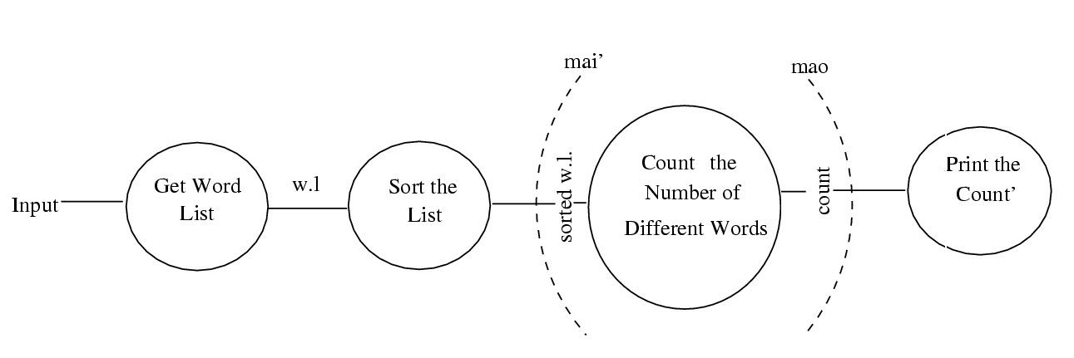
Example 1 – counting the no of different words in a file

Slide 18
Step 2…
Most abstract inputs: data elements in DFG that are furthest from the actual inputs, but can still be considered as incoming
These are logical data items for the transformation
May have little similarity with actual inputs.
Often data items obtained after error checking, formatting, data validation, conversion etc.

Slide 19
Step 2…
Travel from physical inputs towards outputs until data can no longer be considered incoming
Go as far as possible, without loosing the incoming nature
Similarly for most abstract outputs
Represents a value judgment, but choice is often obvious
Bubbles between mai and mao: central transforms
These transforms perform the basic transformation
With mai and mao the central transforms can concentrate on the transformation

Slide 20
Step 2…
Problem View: Each system does some i/o and some processing
In many systems the i/o processing forms the large part of the code
This approach separates the different functions
  subsystem primarily performing input
  subsystem primarily performing transformations
  subsystem primarily performing output presentation

Slide 21
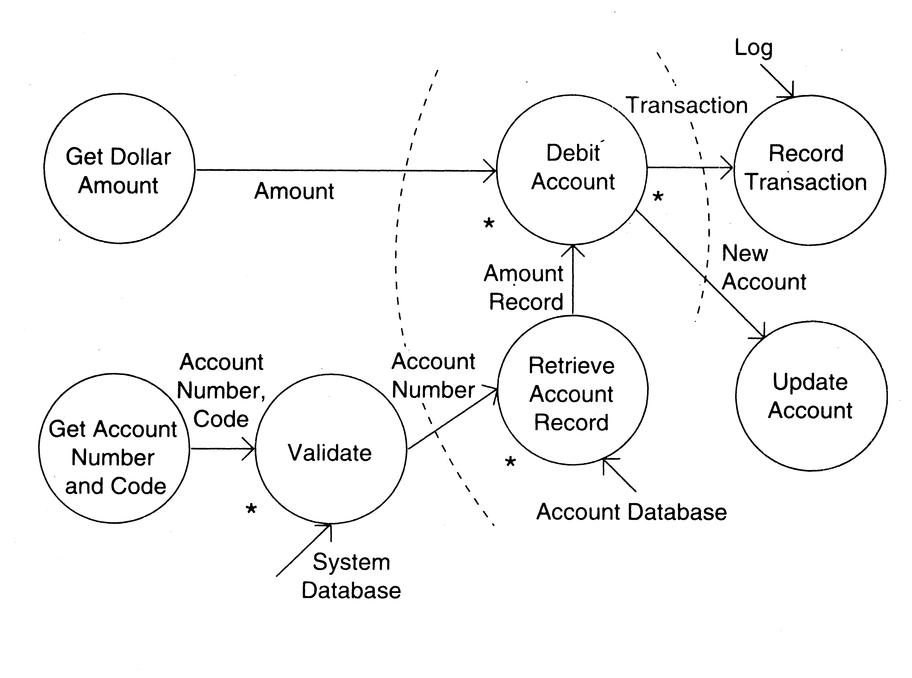
Example 2 – ATM

Slide 22
First Level Factoring
First step towards a structure chart
Specify a main module
For each most abstract input data item, specify a subordinate input module
The purpose of these input modules is to deliver to main the mai data items
For each most abstract output data element, specify an output module
For each central transform, specify a subordinate transform module
Inputs and outputs of these transform modules are specified in the DFD

Slide 23
First level factoring is straight forward
Main module is a coordinate module
Some subordinates are responsible for delivering the logical inputs
These are passed to transform modules to get them converted to logical outputs
Output modules then consume them
Divided the problem into three separate problems
Each of the three diff. types of modules can be designed separately
These modules are independent

Slide 24
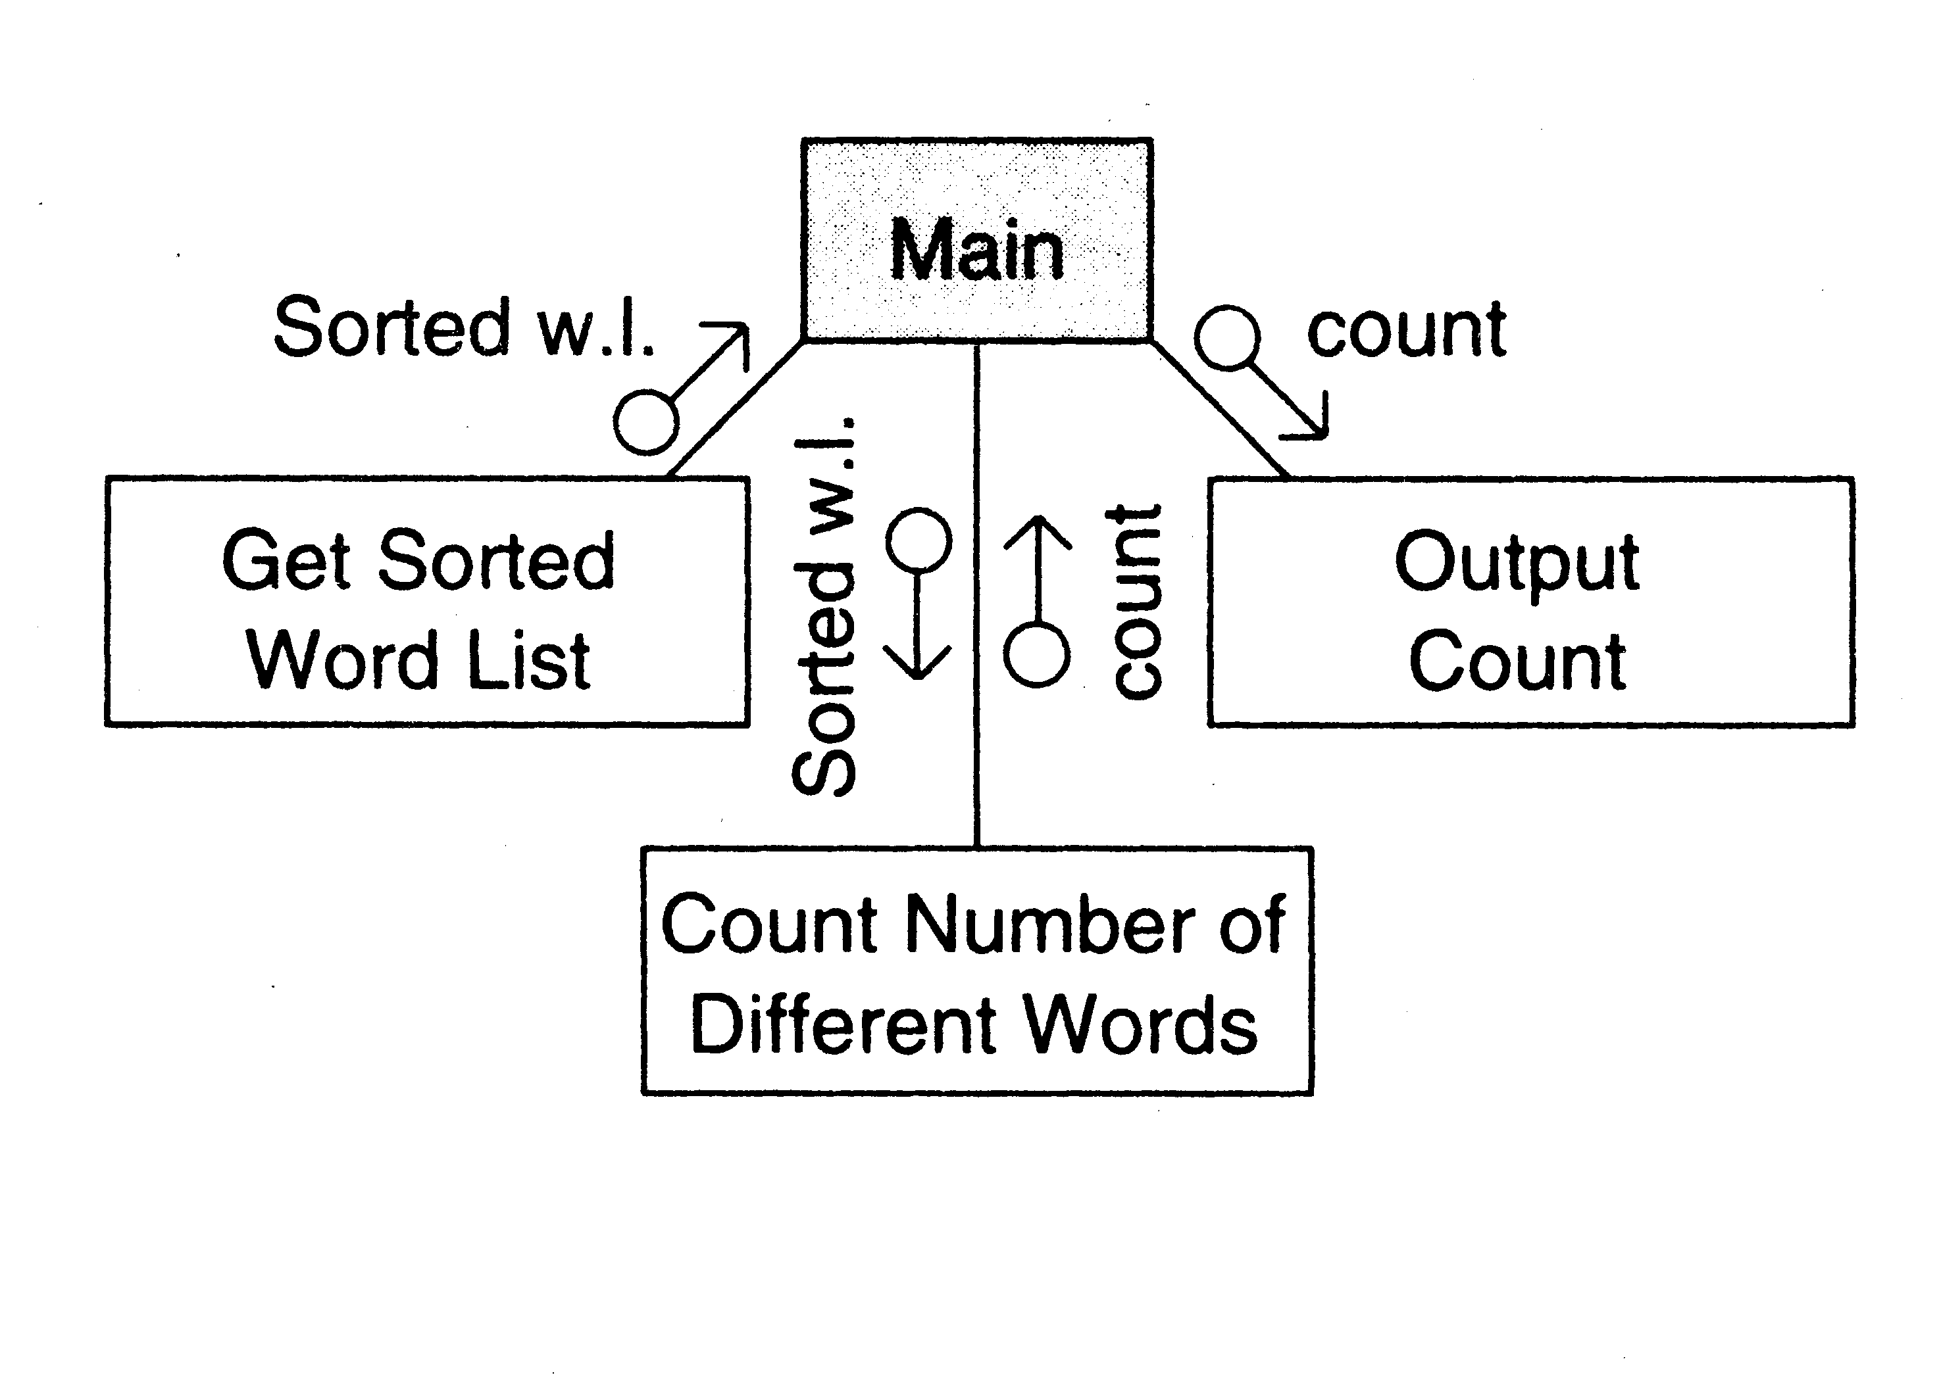
Example 1

Slide 25
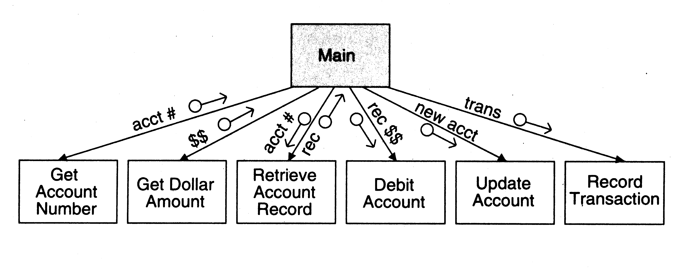
Example 2

Slide 26
Factoring Input modules
The transform that produced the mai data is treated as the central transform
Then repeat the process of first level factoring
Input module being factored becomes the main module
A subordinate input module is created for each data item coming in this new central transform
A subordinate module is created for the new central transform
Generally there will be no output modules

Slide 27
The new input modules are factored similarly Till the physical inputs are reached
Factoring of the output modules is symmetrical
Subordinates - a transform and output modules
Usually no input modules

Slide 28
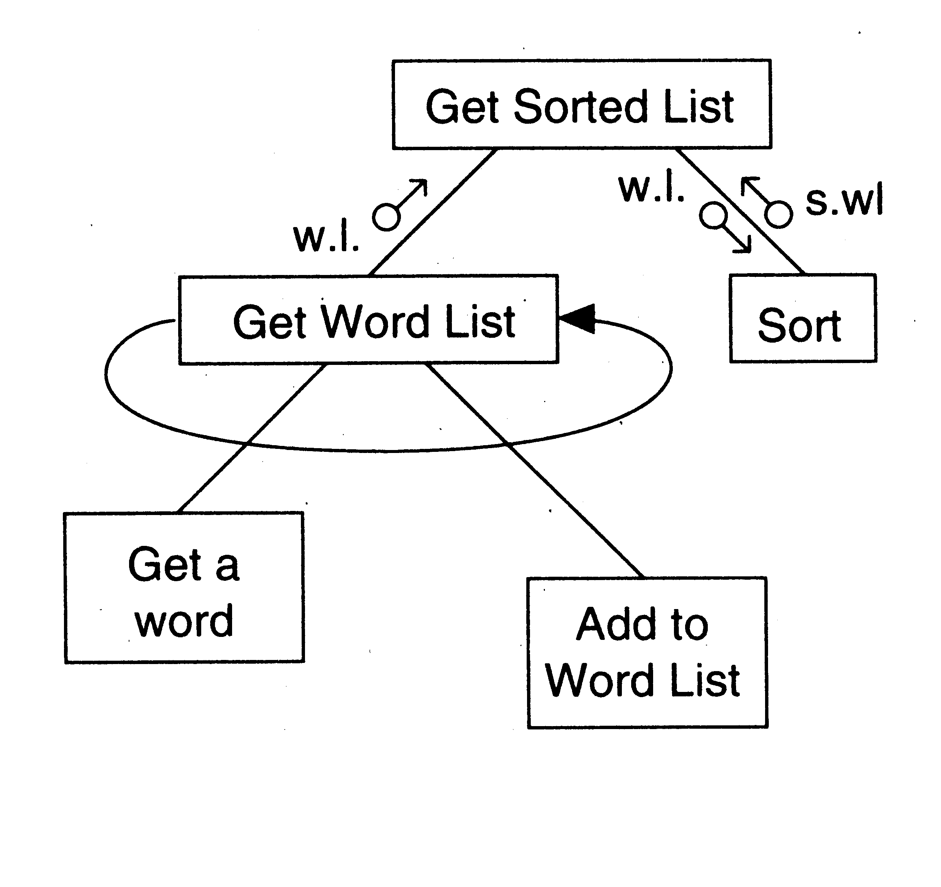
Example 1

Slide 29
Factoring Central Transforms
Factoring i/o modules is straight forward if the DFD is detailed
No rules for factoring the transform modules
Top-down refinement process can be used
Goal: determine sub-transforms that will together compose the transform
Then repeat the process for newly found transforms
Treat the transform as a problem in its own right
Draw a data flow graph
Then repeat the process of factoring
Repeat this till atomic modules are reached

Slide 30
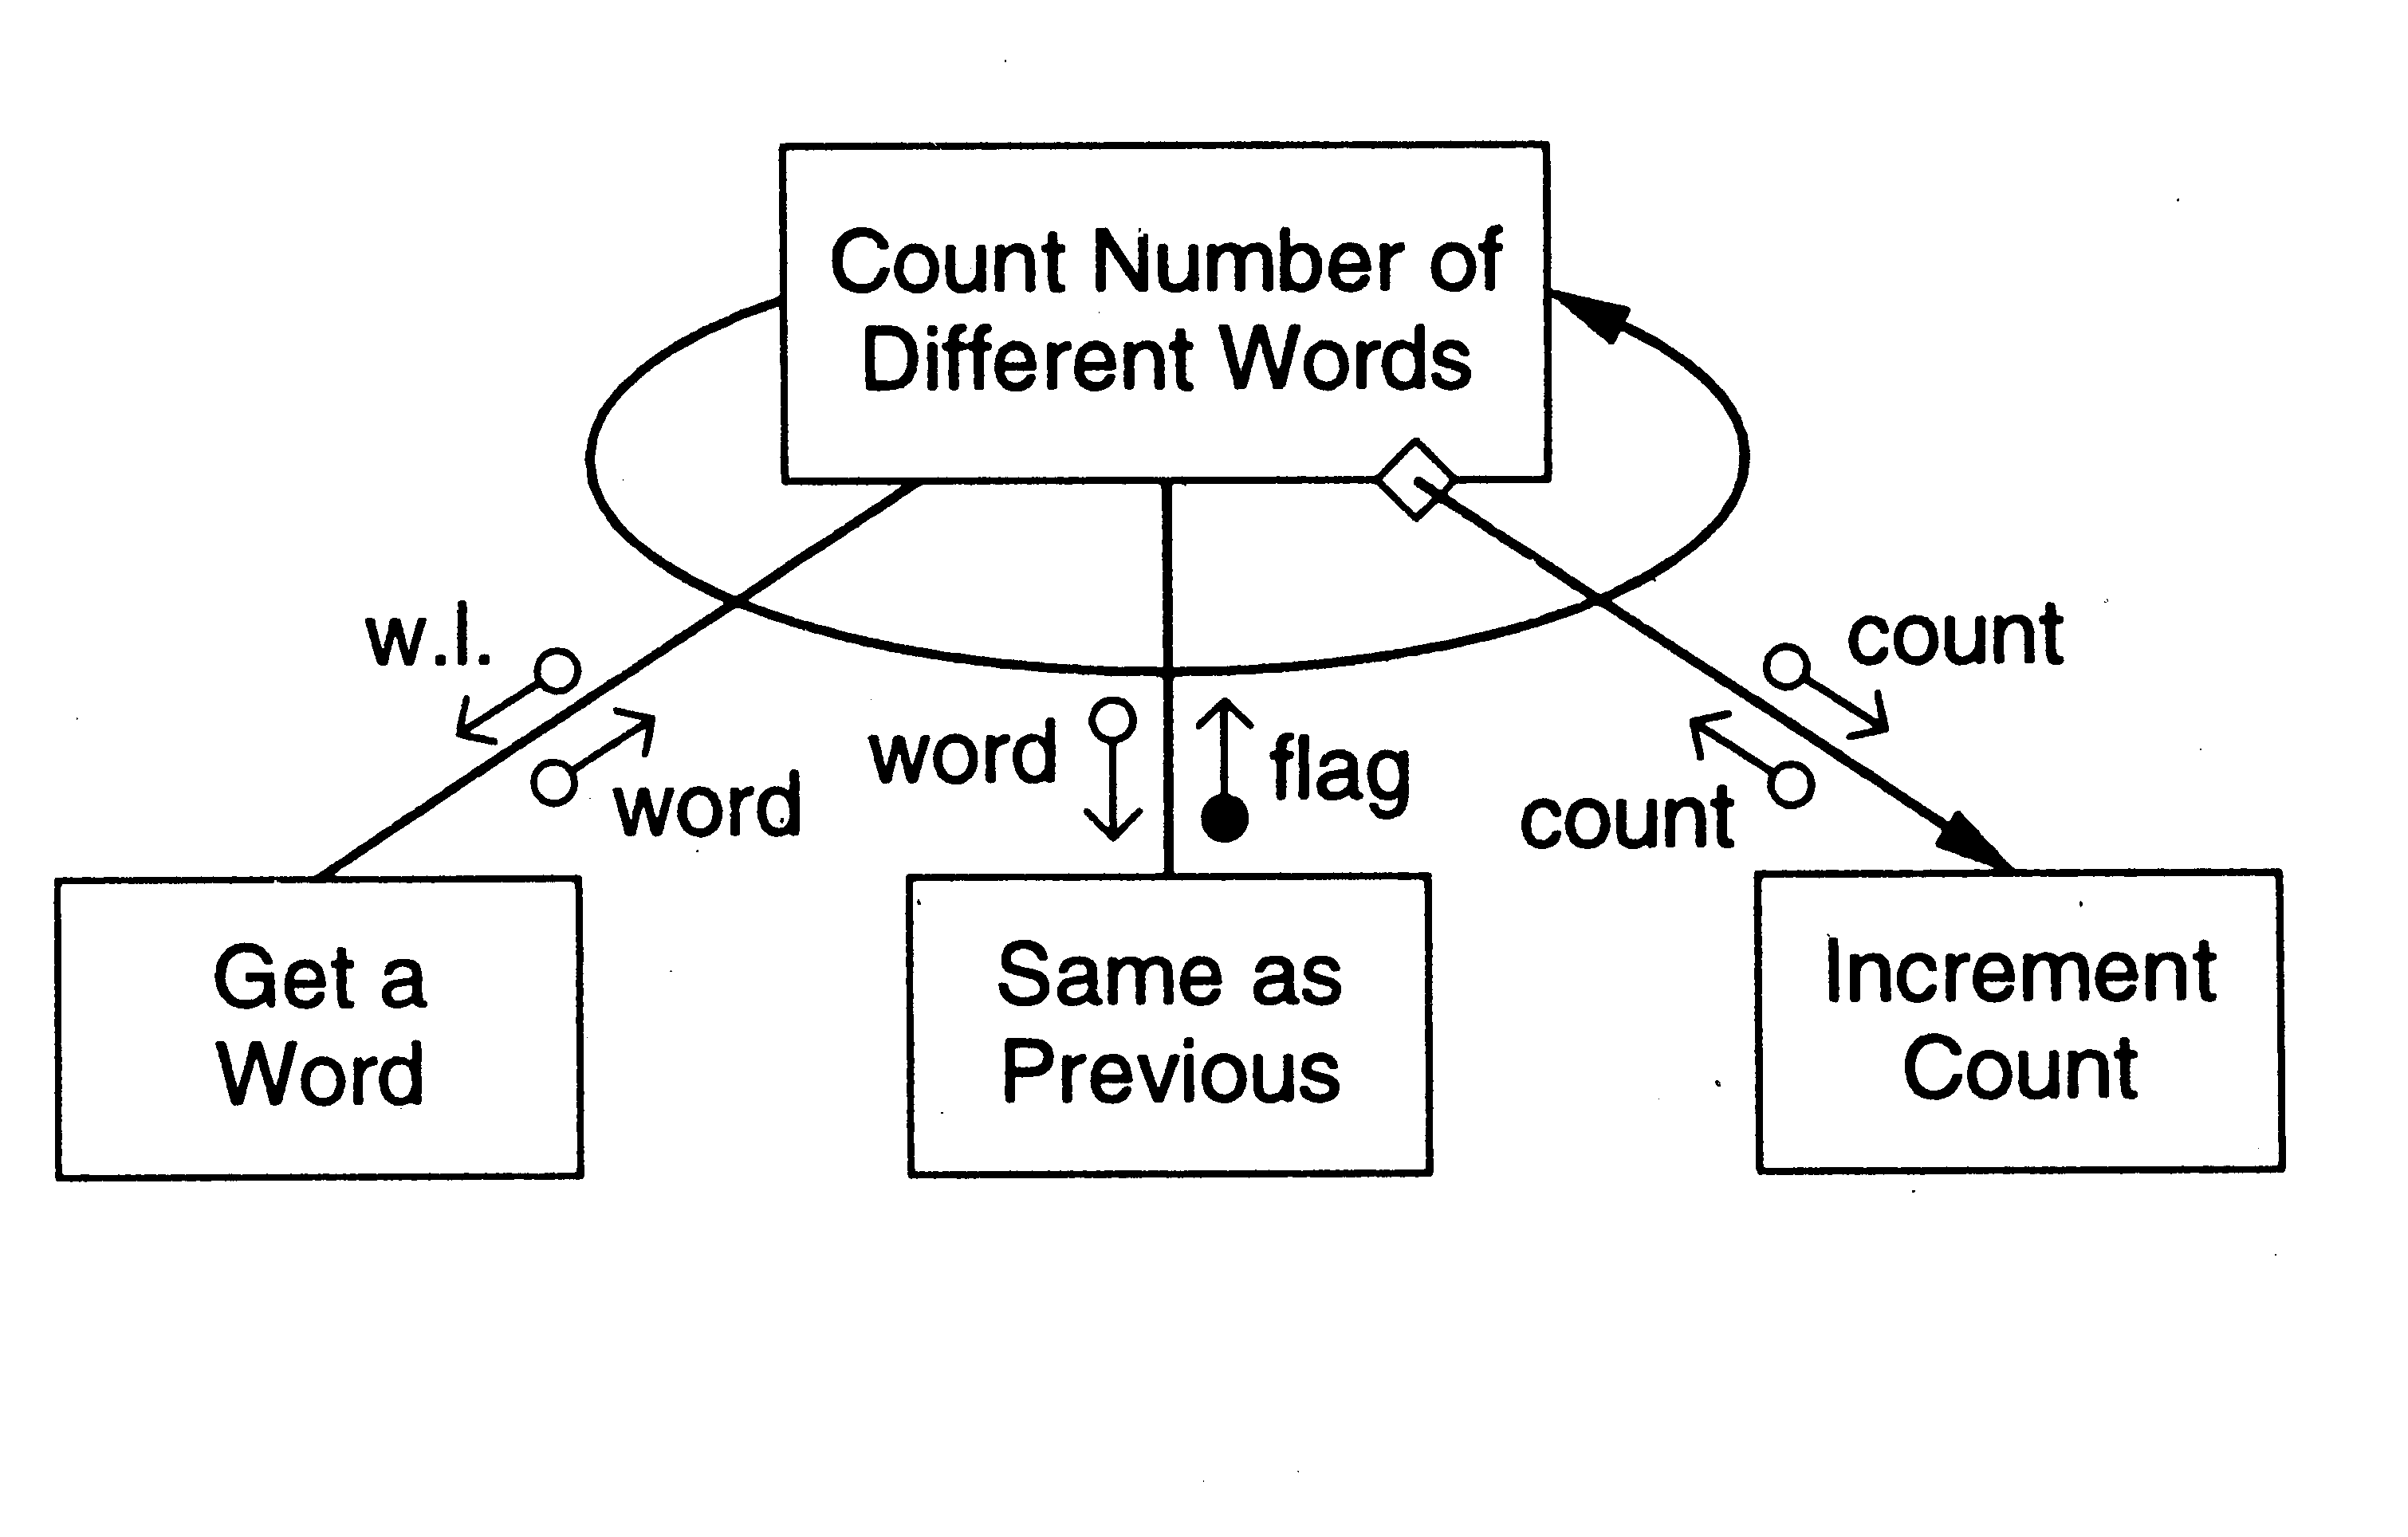
Example 1

Slide 31
Design Heuristics
The above steps should not be followed blindly
The structure obtained should be modified if needed
Low coupling, high cohesion being the goal
Design heuristics used to modify the initial design
Design heuristics - A set of thumb rules that are generally useful
Module Size: Indication of module complexity Carefully examine modules less than a few lines or greater than about 100 lines
Fan out and fan in
A high fan out is not desired, should not be increased beyond 5 or 6
Fan in should be maximized

Slide 32
Scope of effect of a module: the modules affected by a decision inside the module
Scope of control: All subordinates of the module
Good thumb rule:
For each module scope of effect should be a subset of scope of control
Ideally a decision should only effect immediate subordinates
Moving up the decision, moving the module down can be utilized to achieve this

Slide 33
Transaction Analysis
The above approach is transform analysis
In this data flows from input to output through various transforms
In transaction processing type situations, many different types of processing are done depending on type
The DFD of such a system shows a bubble splitting data into many streams
In execution, one of the streams is followed
Transaction analysis is best for this

Slide 34
DFD shown in figure
Note the use of + signifying OR
There is a transaction center, T
T takes input & then performs different transformations
This can be converted to SC as shown
In smaller systems, dispatching may be done in the transaction center itself

Slide 35
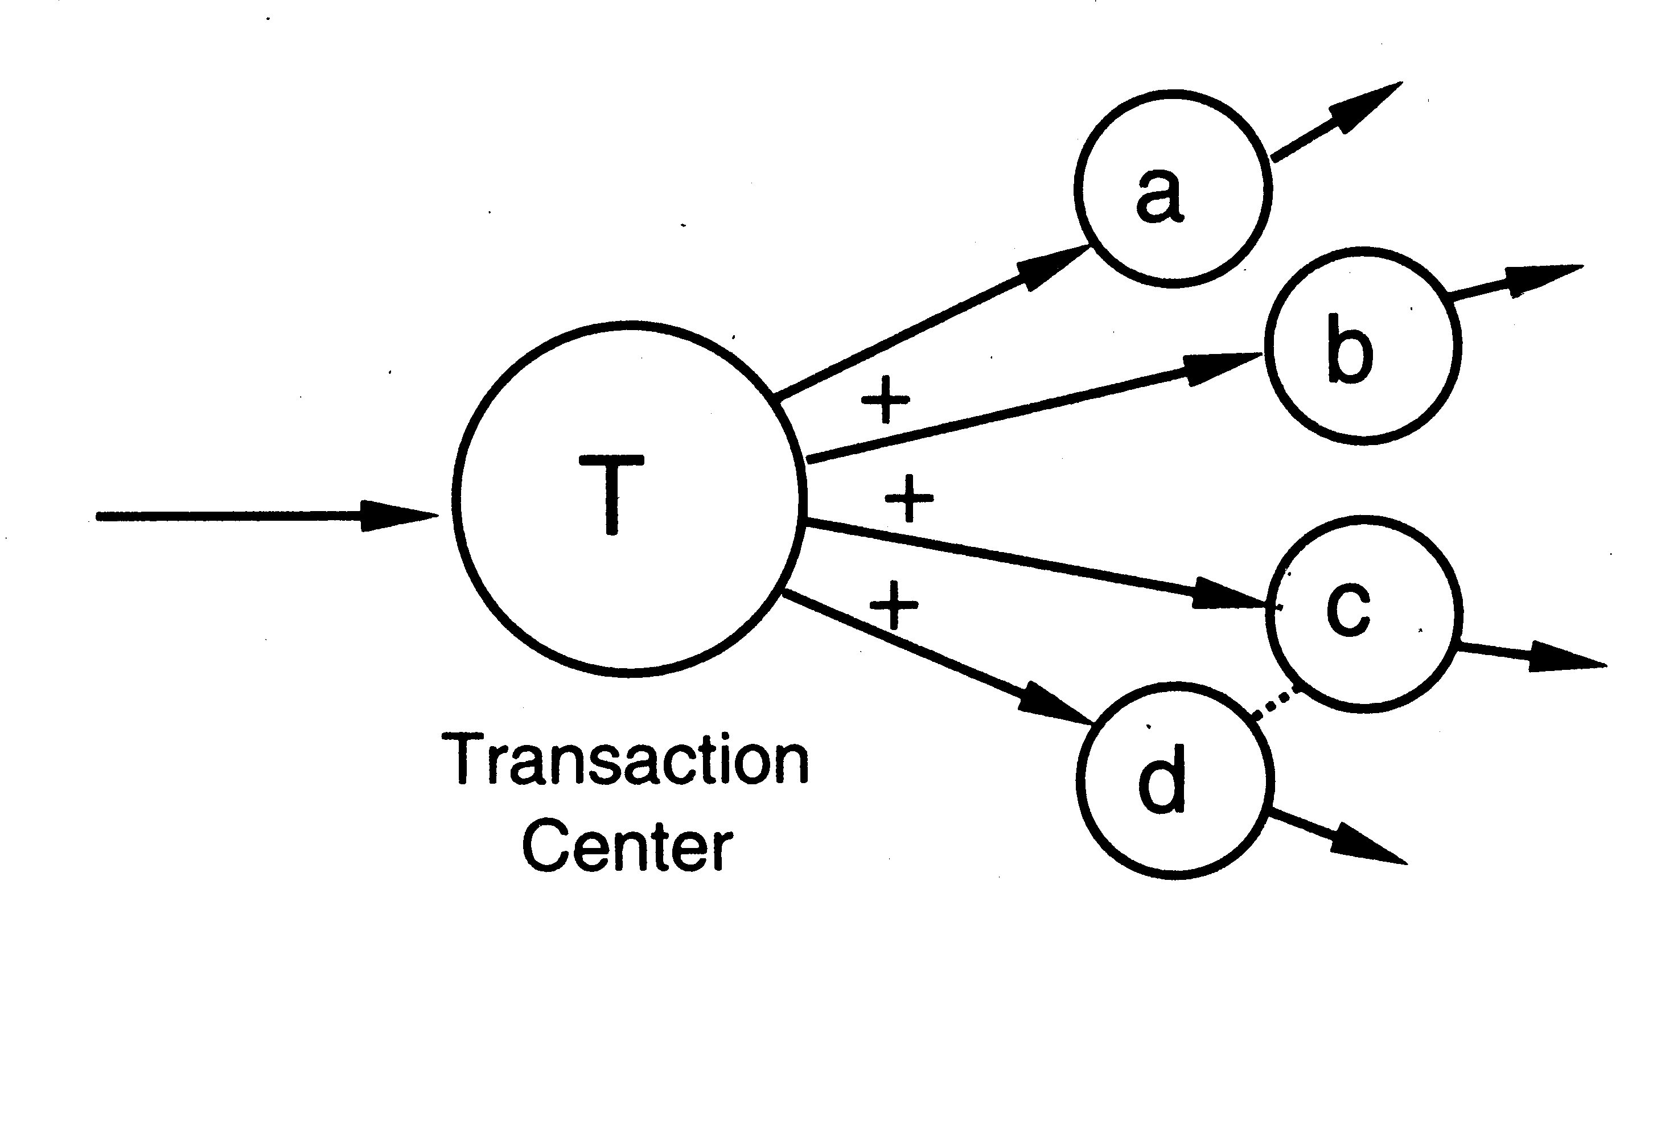
DFD for transaction analysis

Slide 36
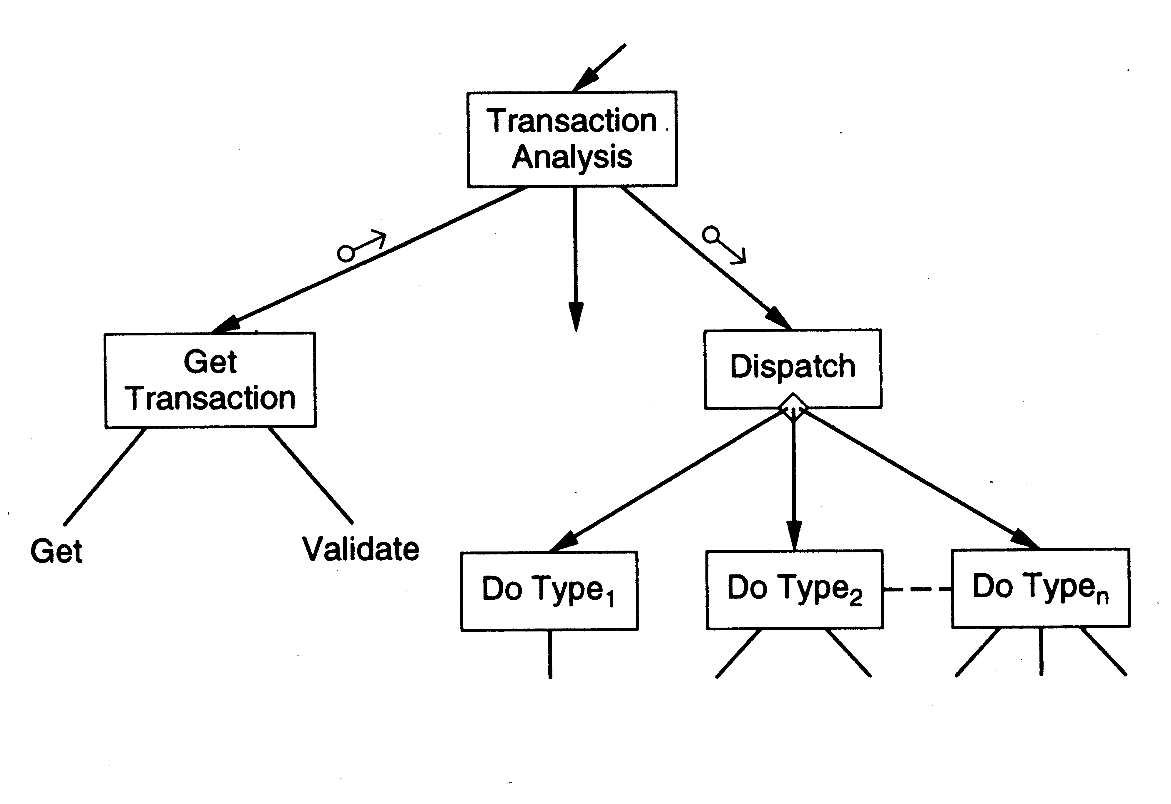
Transaction analysis…

Slide 37
Summary
Goal of design phase: produce simpler & modular design
Structured design methodology is one way to create modular design
It partitions the system into input subsystems, output subsystems & transform subsystems
Idea: Many systems use a lot of code for handling inputs & outputs
SDM separates these concerns
Then each of the subsystems is factored using the DFD
The design is finally documented & verified before proceeding

Slide 38
Detailed Design
HLD does not specify module logic
This is done during detailed design
Process Design Logic (PDL) can also be used for detailed design of modules
PDL can be used to specify the complete design - architectural as well as logic design
The degree of detail desired is decided by the designer
One way to communicate a design: use natural language
Is imprecise and can lead to misunderstanding

Slide 39
Other extreme is to use a formal language
Such representations often have a lot of detail,
  necessary for implementation, but
  not important for communicating the design
These details are often a hindrance to understanding

Slide 40
Ideally would like a language that is
  as precise as possible
  Does not need too much detail,
  target language independent
  can be easily converted in to an implementation
This is what PDL attempts to do.
PDL has outer syntax of a structure programming language
Vocabulary of a natural language (English in our case)
It can be thought as "structured english"
Some automated processing can be done on PDL

Slide 41
E.g.. determine the min and max of a set of numbers in a file
A design in PDL is:
  minmax (in file)
  ARRAY a
  DO UNTIL end of input
  READ an item into a
  ENDDO
  max, min: = first item of a
  DO FOR each item in a
  IF max < item THEN set max to item
  IF min > item THEN set min to item
  ENDDO
  END

Slide 42
The entire logic is described
Few implementation details
For implementation, the pseudo statements will have to be
  converted into programming language statements
A design can be expressed in level of detail
  suitable for the problem
PDL allows a successive refinement approach
Encourages use of structured language constructs

Slide 43
The basic constructs of PDL
if-then-else construct Like Pascal
Conditions and the statements need not be stated formally
A general CASE statement
Some examples of CASE
  CASE OF transaction type
  CASE OF operator type
The DO construct: used to indicate repetition
  DO iteration criteria
  one or more statements
  ENDDO

Slide 44
The iteration criteria need not be stated formally
Examples of valid use are:
  DO WHILE there are characters in input file
  DO UNTIL the end of file is reached
  DO FOR each item in the list EXCEPT when item is zero.
A variety of data structures can be defined Eg. list, tables, scalar, records, arrays etc. All constructs should be programmable

Slide 45
Design Verification
Main objective: does the design implement the requirements
Analysis for performance, efficiency, etc may also be done
If formal languages used for design representation, tools can help
Design reviews remain the most common approach for verification

Slide 46


Slide 47
Background
Basic purpose to provide a quantitative evaluation of the design (so the final product can be better)
Size is always a metric – after design it can be more accurately estimated
  Number of modules and estimated size of each is one approach
Complexity is another metric of interest – will discuss a few metrics

Slide 48
Network Metrics
Focus on structure chart; a good SC is considered as one with each module having one caller (reduces coupling)
The more the SC deviates from a tree, the more impure it is
Graph impurity = n – e – 1
n – nodes, e- edges in the graph
Impurity of zero means tree; as this number increases, the impurity increases

Slide 49
Stability Metrics
Stability tries to capture the impact of a change on the design
Higher the stability, the better it is
Stability of a module – the number of assumptions made by other modules about this module
  Depends on module interface, global data the module uses
  Are known after design

Slide 50
Information Flow Metrics
Complexity of a module is viewed as depending on intra-module complexity
Intramodule estimated by module size and the information flowing
  Size in LOC
  Inflow – info flowing in the module
  Outflow – info flowing out of the module
Dc = size * (inflow * outflow)²

Slide 51
Information flow metrics…
(inflow * outflow) represents total combination of inputs and outputs
Its square reps interconnection between the modules
Size represents the internal complexity of the module
Product represents the total complexity

Slide 52
Identifying error-prone modules
Uses avg complexity of modules and std dev to identify error prone and complex modules:
  Error prone: If Dc > avg complexity + std_dev
  Complex: If avg complexity < Dc < avg + std dev
  Normal: Otherwise

Slide 53
Metrics with detailed design
When logic is known, internal complexity metrics can be determined
We will cover all detailed design based metrics along with code metrics

